Slide 1
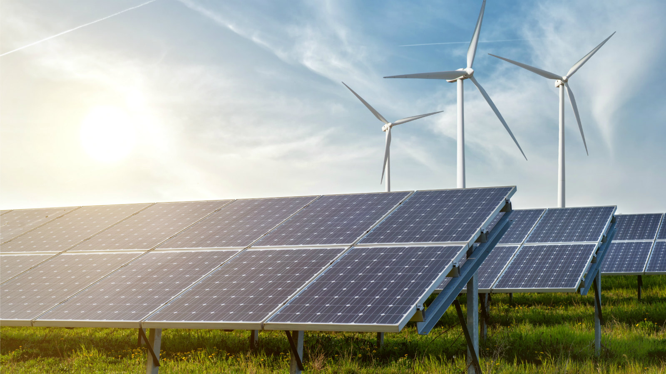
Unit 11
SOURCES OF ENERGY
Language Focus

Slide 2
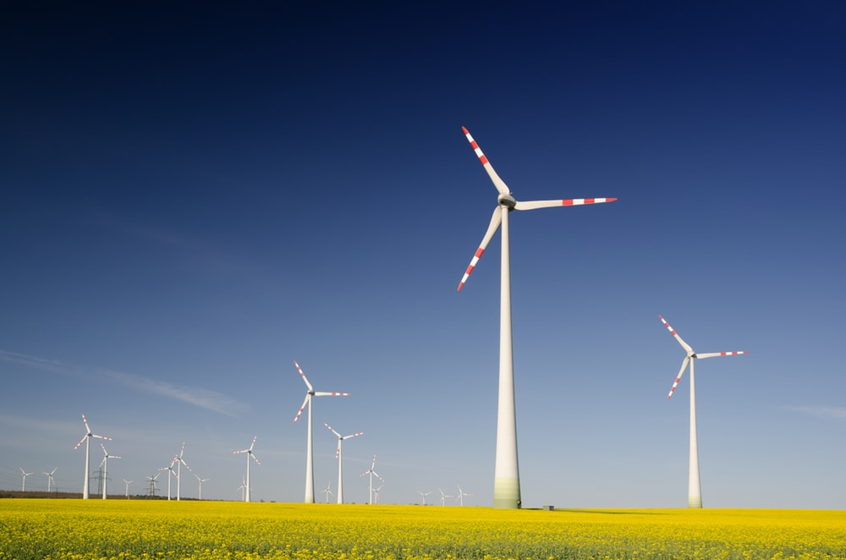
GRAMMAR
RELATIVE CLAUSES
REPLACED BY
PARTICIPLES AND TO INFINITIVES

Slide 3
who spoke
The man to John is my brother.
V_{ing}
Active meaning
V_{ing}
The man speaking to John is my brother
Relative clause reduced by
who were punished
V_{3/ed}
The students by the teacher are lazy.
Passive meaning
V_{3/ed}
The students punished by the teachers are lazy.
who flew
Yuri Gagarin was man into space.
the first
the first, the second…
the last, the only, superlative (the_est)
To V
Yuri Gagarin was the first man to fly into space.
To V
be +V_{3/ed}
who was offered
This is person the job.
the third
To be V_{3/ed}
This is the third person to be offered the job.

Slide 4
Practice 1

Slide 5
Exercise 1
Rewrite the following sentences, using a present participial phrase.
1
who is playing
The boy the piano is Ben.
☞ The boy playing the piano is Ben.
2
who is coming
Do you know the woman towards us?
☞ Do you know the woman coming towards us?
3
The people for the bus in the rain are getting wet.
who are waiting
☞ The people waiting for the bus in the rain are getting wet.
4
who are researching
The scientists the causes of cancer are making progress.
☞ The scientists researching the causes of cancer are making progress.
5
The fence our house is made of wood
which surrounds
☞ The fence surrounding our house is made of wood.
6
We have an apartment the park.
which overlooks
☞ We have an apartment overlooking the park.

Slide 6
Exercise 2
Rewrite the following sentences, using a past participial phrase.
1
which are presented
The ideas in that book are interesting.
☞ The ideas presented in that book are interesting.
2
I come from a city in the southern part of the country.
that is located
☞ I come from a city located in the southern part of the country.
3
They live in a house in 1980.
that was built
☞ They live in a house built in 1980
4
which were published
The photographs in the newspaper were extraordinary.
☞ The photographs published in the newspaper were extraordinary.
5
The experiment at the University of Chicago was successful
which was conducted
☞ The experiment conducted at the University of Chicago was successful.
6
They work in a hospital by the government.
which was sponsored
☞ They work in a hospital sponsored by the government.

Slide 7
Exercise 3
Rewrite the following sentences, using a past participial phrase.
1
John was man the top of the mountain.
the last
who reached
☞ John was the last man to reach the top of the mountain.
2
The last
who leaves
person the room must turn off the light.
☞ The last person to leave the room must turn off the light.
3
that we must see
person is Mr. Smith
The first
☞ The first person to see is Mr. Smith.
4
who was killed
This is person in that way.
the second
☞ This is the second person to be killed in that way.
5
who catches
person the ball will be the winner.
The first
☞ The fist person to catch the ball will be the winner

Slide 8
Practice 2

